Slide 1

Sample and Population

Slide 2
Sample and Population
Almost all statistical studies are based on sample.
Imagine, we need to identify average height of 300,000 students. Its almost impossible to measure individual heights of all students.>> POPULATION
Therefore, we draw sample of 200 students, to identify the average height of a student. >> SAMPLE

Slide 3


Slide 4
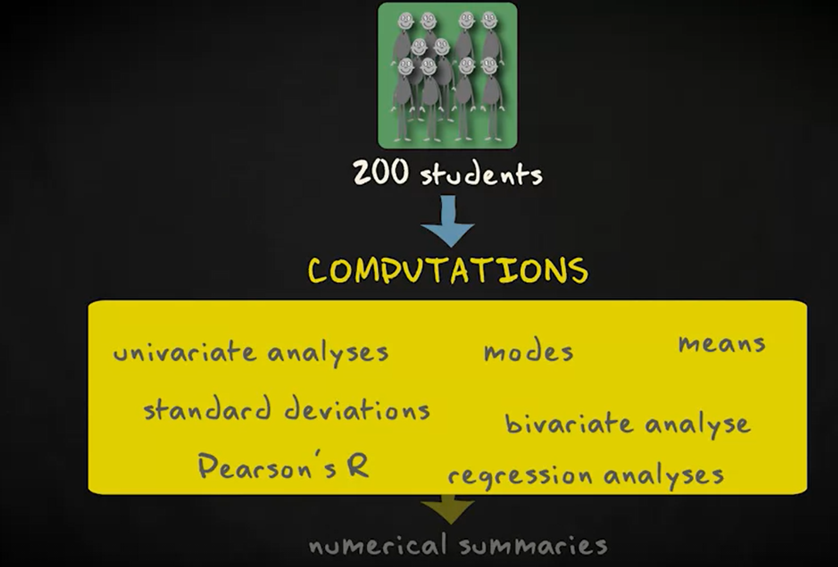
Descriptive statistics - The methods for summarizing sample data.

Slide 5
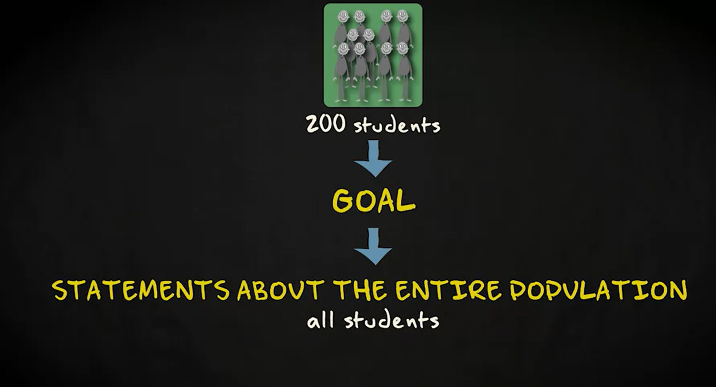

Slide 6
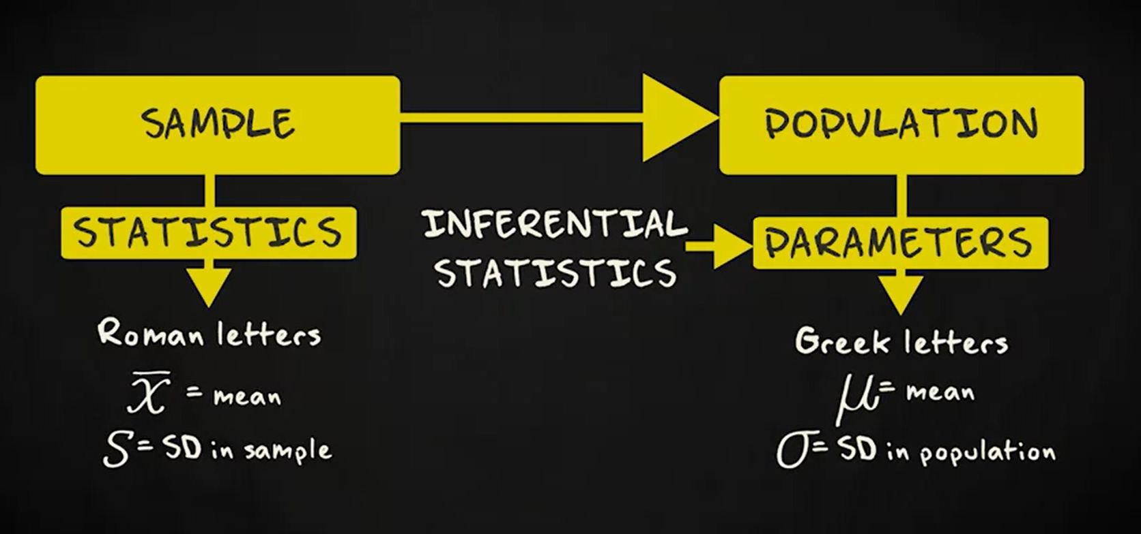

Slide 7
Inferential Statistics
Draw conclusion of a population based on data coming from sample.

Slide 8
How to draw sample?
Sample is a subset of a population.
We want representative sample.
Simple random sample- each subject same chance of being selected.
Random multi-stage cluster sample.
Stratified random sample.

Slide 9
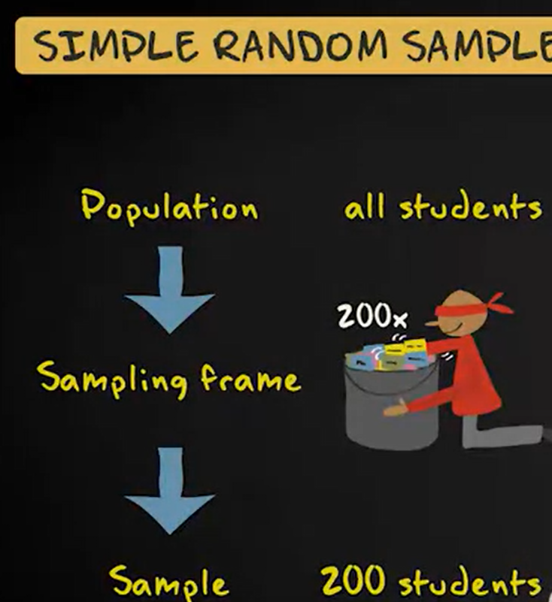
Simple random sample (Sampling methods)

Slide 10
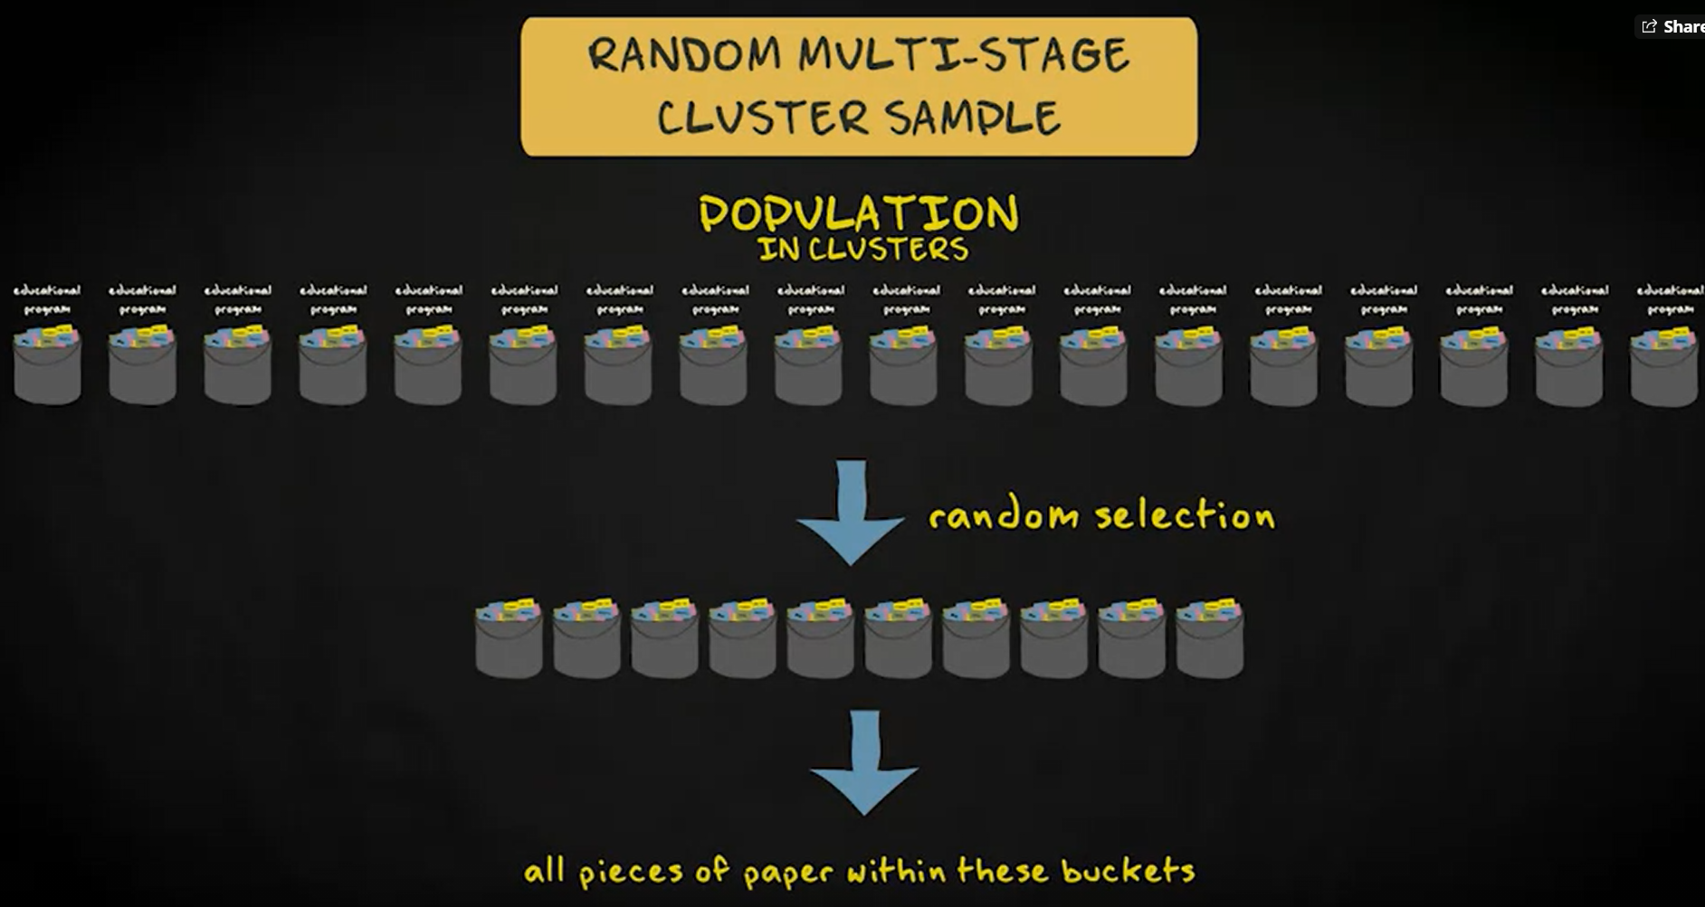
Random Multi-stage Cluster Sample (Sampling methods)

Slide 11
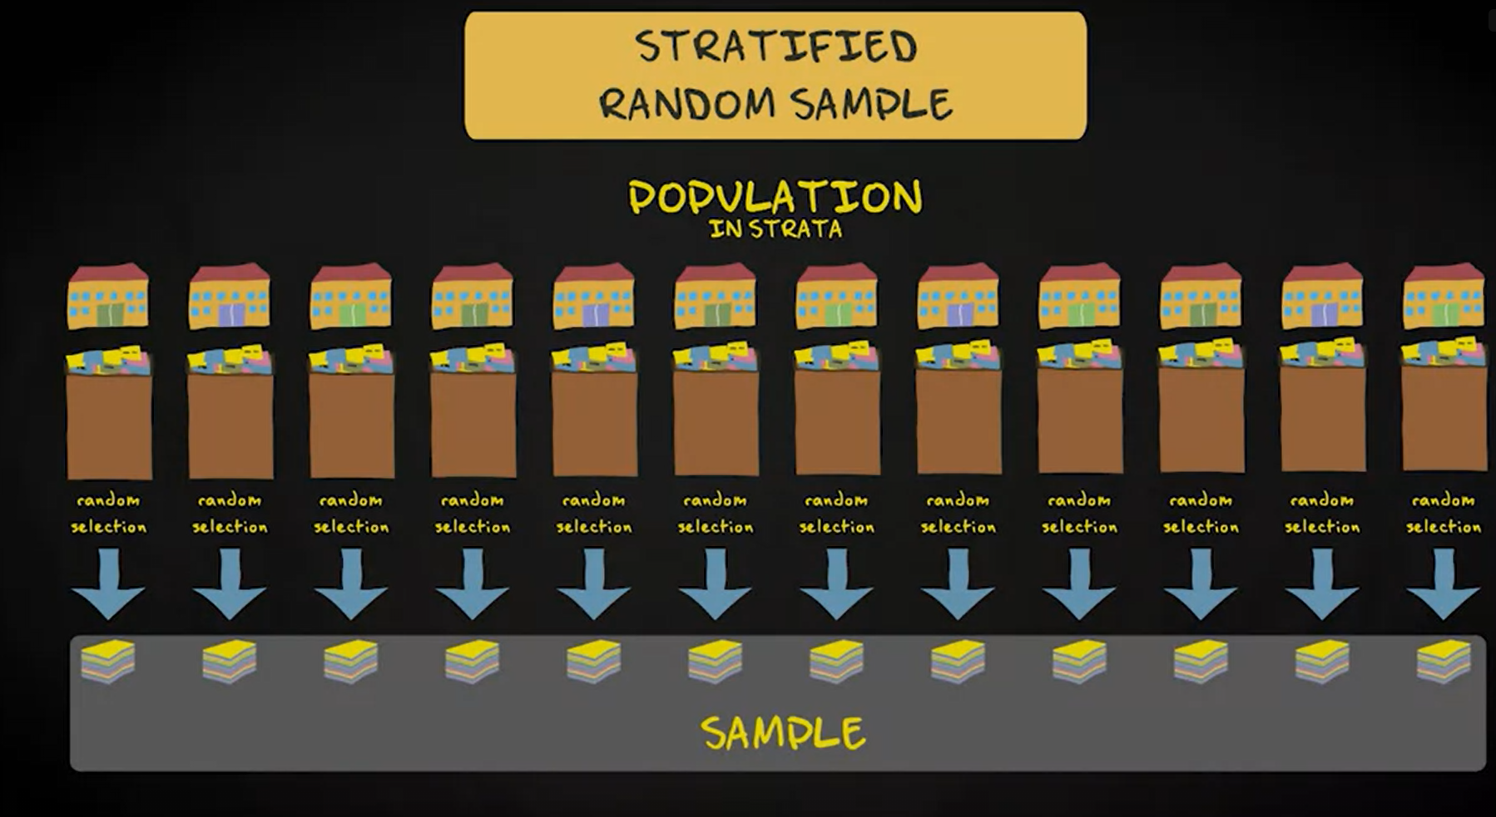
Stratified Random Sample (Sampling method)

Slide 12
Bigger is better
Provided the sample is random

Slide 13
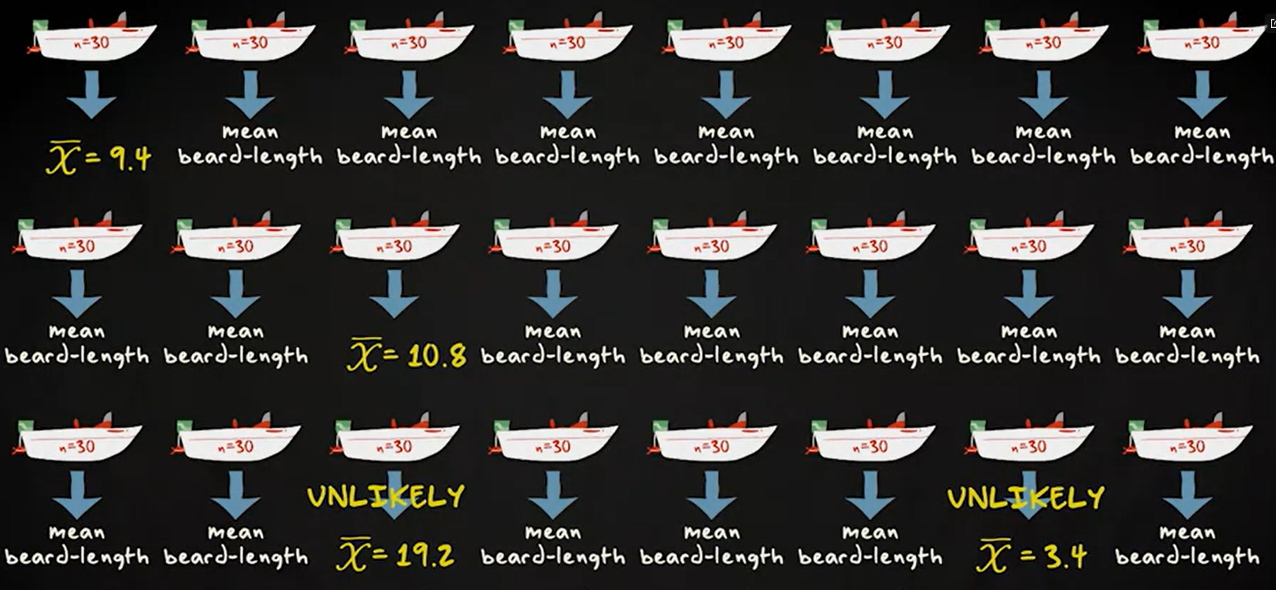
Sampling distribution

Slide 14
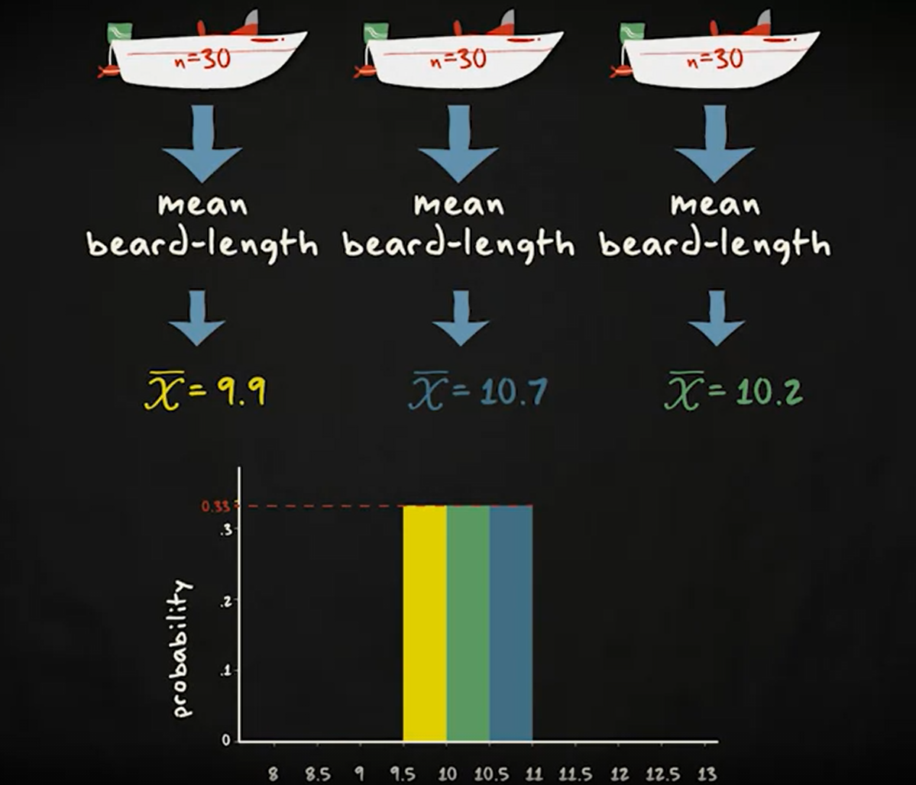
Sampling distribution

Slide 15
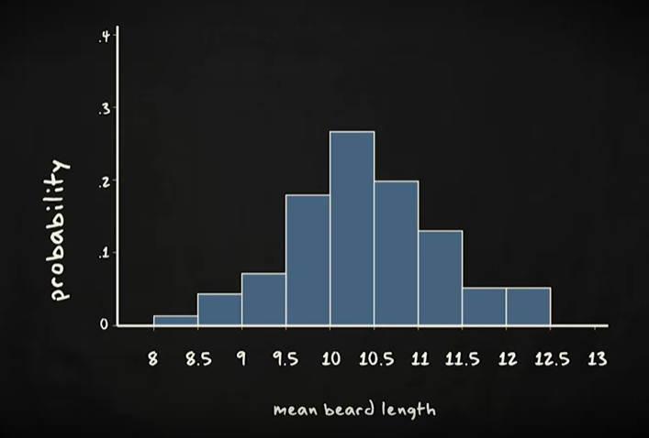
Sampling distribution

Slide 16
The sampling distribution
If we draw an infinite number of sample from a sampling distribution, it looks like a normal distribution. The mean of a distribution equals mean of the population.

Slide 17
Central limit theorem
The sampling distribution of sample mean is approximately normal (if n is sufficiently large). That is n >=30.

Slide 18
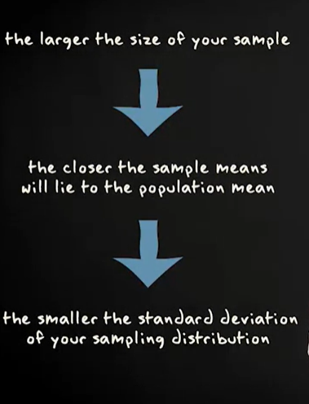
Central limit theorem

Slide 19
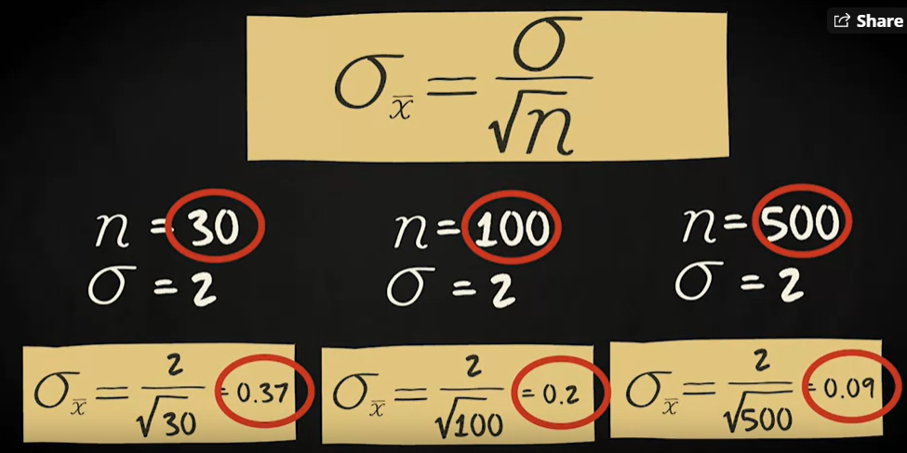
Central limit theorem

Slide 20
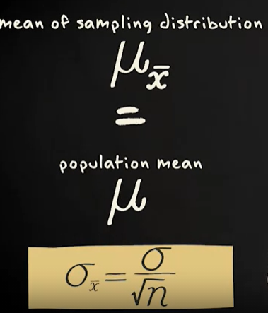
Central limit theorem

Slide 21
Three distribution
Population distribution
Data/Sample distribution
Sampling distribution

Slide 22
